Slide 1
Using the EyeLink 1000 Plus UCLA Cognitive Area
Ringo Huang
Lab Meeting
03/08/2022

Slide 2
Overview
Experiment design for pupillometry
How to correct for gaze position
How to luminance norm
Programming your experiment
Running your study
Preprocessing your data
Materials for this demo can be found here:
https://github.com/RingoHHuang/ucla-eyelink-demo

Slide 3
Experiment Design for Pupillometry

Slide 4
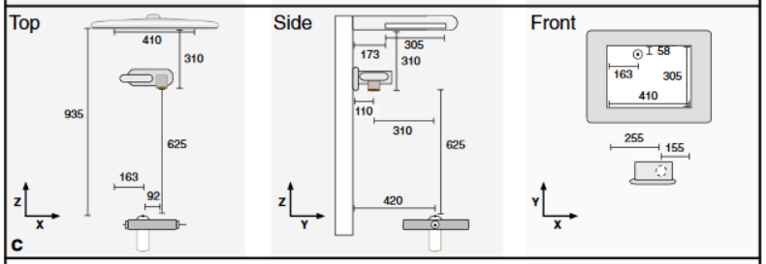
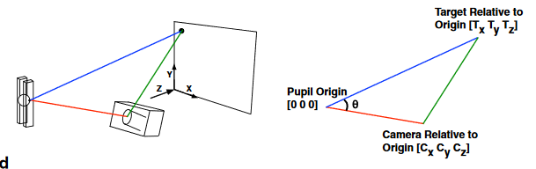
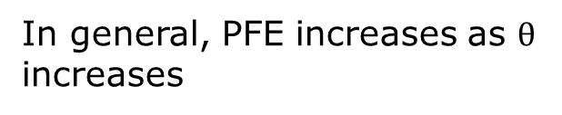
How do experimenters adjust for changes to pupil size based on gaze location?
Pupil foreshortening error (PFE) – the pupil image is a 2D projection whose area decreases as the eye rotates away from the camera
Set-up to minimize PFE:
Place camera as close to the line-of-sight between the pupil and stimuli as possible
Use pupil data from the eye that is closest to the lens of the camera
Place screen as far back from the participant as possible
In general, PFE increases as $θ$ increases

Slide 5
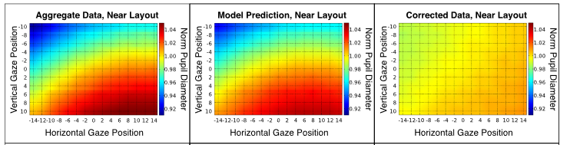
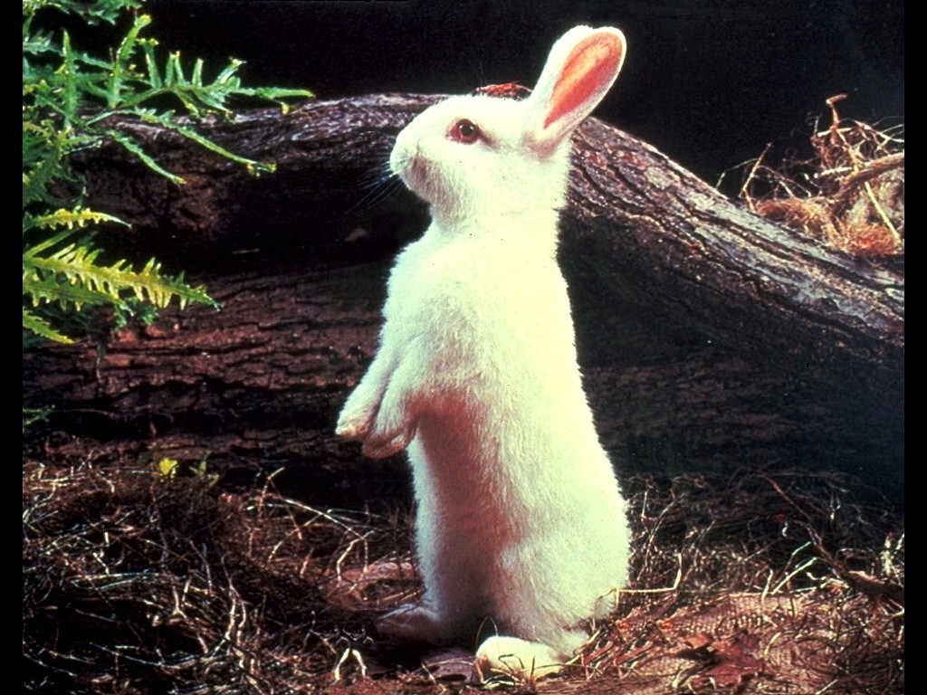
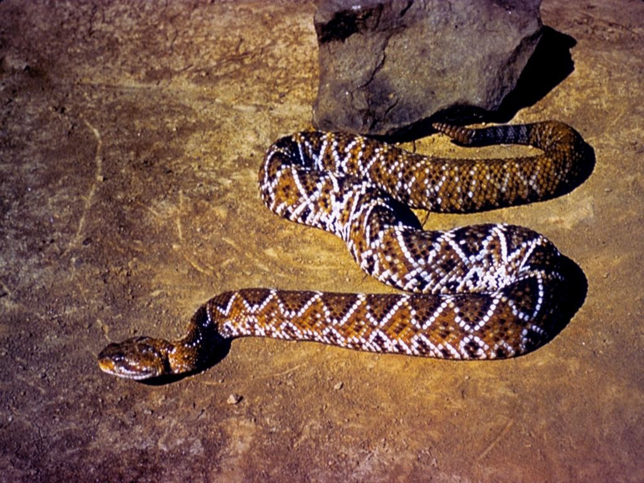
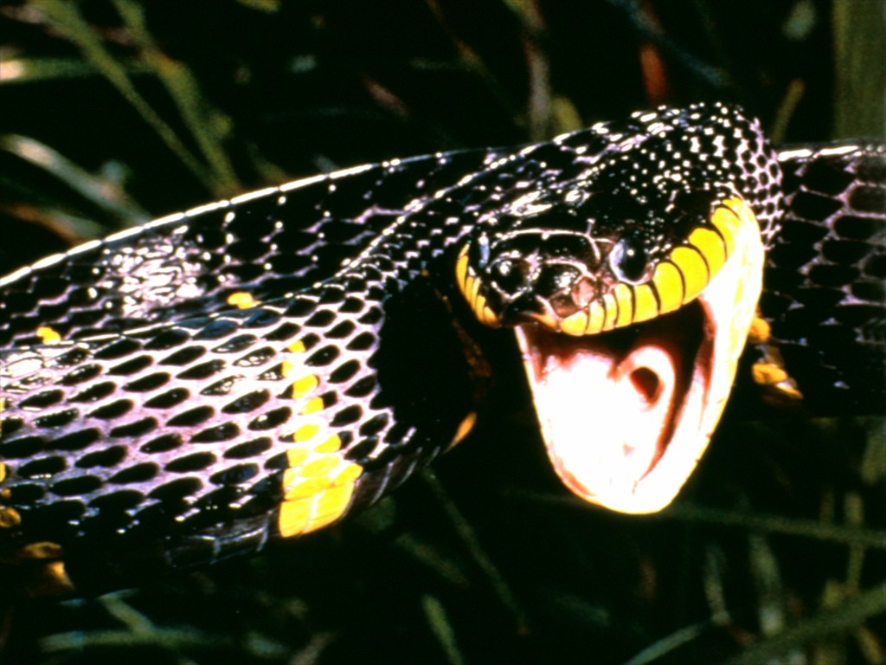
How do we reduce Pupil Foreshortening Error in our experiments?
Control fixation
Eliminates PFE
No free viewing
Constrain viewing area
Permits some free viewing
Introduces some PFE
Smaller viewing area reduces the ability to resolve small changes in gaze
Constrain viewing along a fixed arc
Controls the PFE between trials
Only useful in special cases
Do nothing
Reduces statistical power
May introduce systematic biases leading to Type 1 errors
+

Slide 6
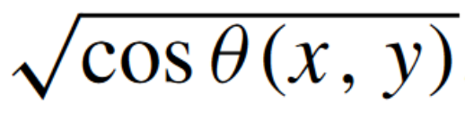
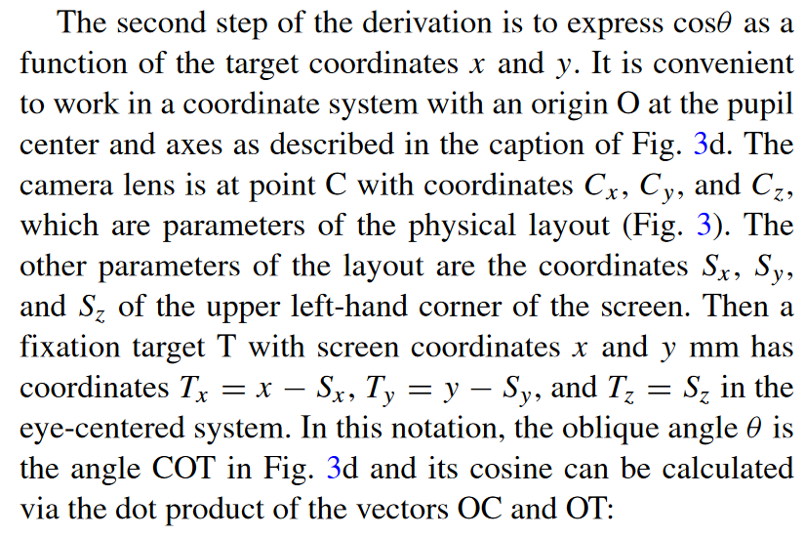
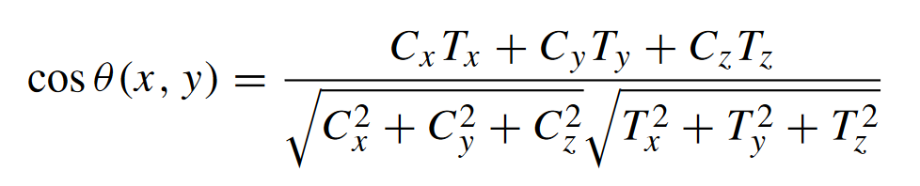
How do we correct for Pupil Foreshortening Error?
PFE correction (Hayes and Petrov, 2015)
PFE =
Raw Pupil Diameter,
Gaze X, Gaze Y
Pupil Foreshortening Error
Corrected Pupil Diameter
(Raw PD/PFE)

Slide 7

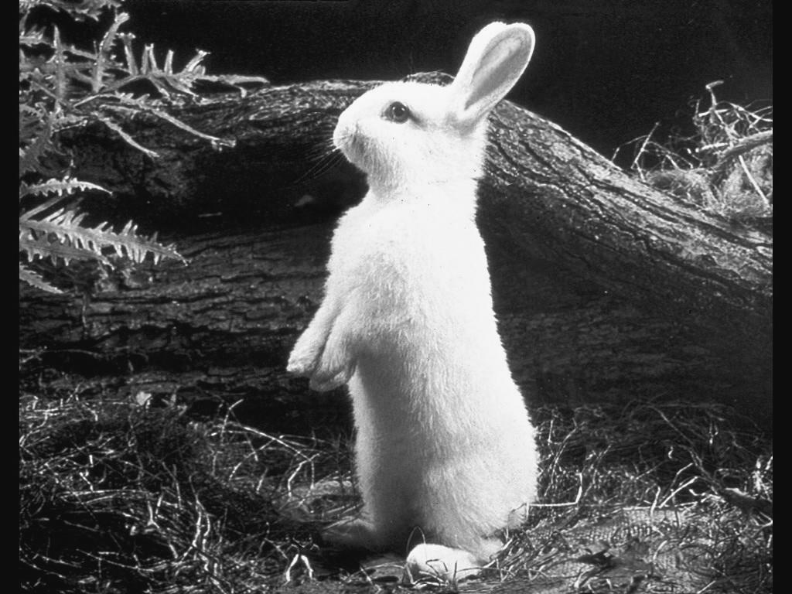
Stimuli Considerations
Auditory Tones
can remove glasses
minimizes noise in pupil data
Isoluminant
Grayscale Images
- use SHINE toolbox to luminance norm the set of images
Isoluminant
Color Images
- can apply SHINE luminance matching to each RGB color channel
Recommend having a central fixation cross during all interstimulus intervals

Slide 8
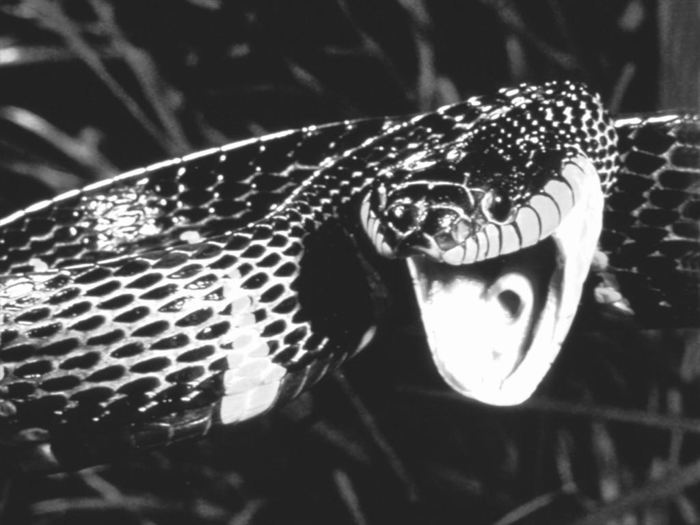
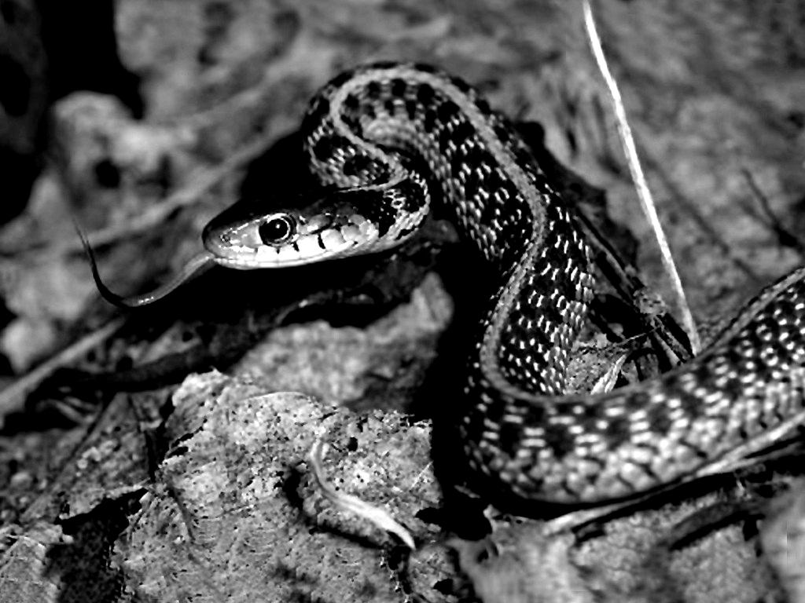
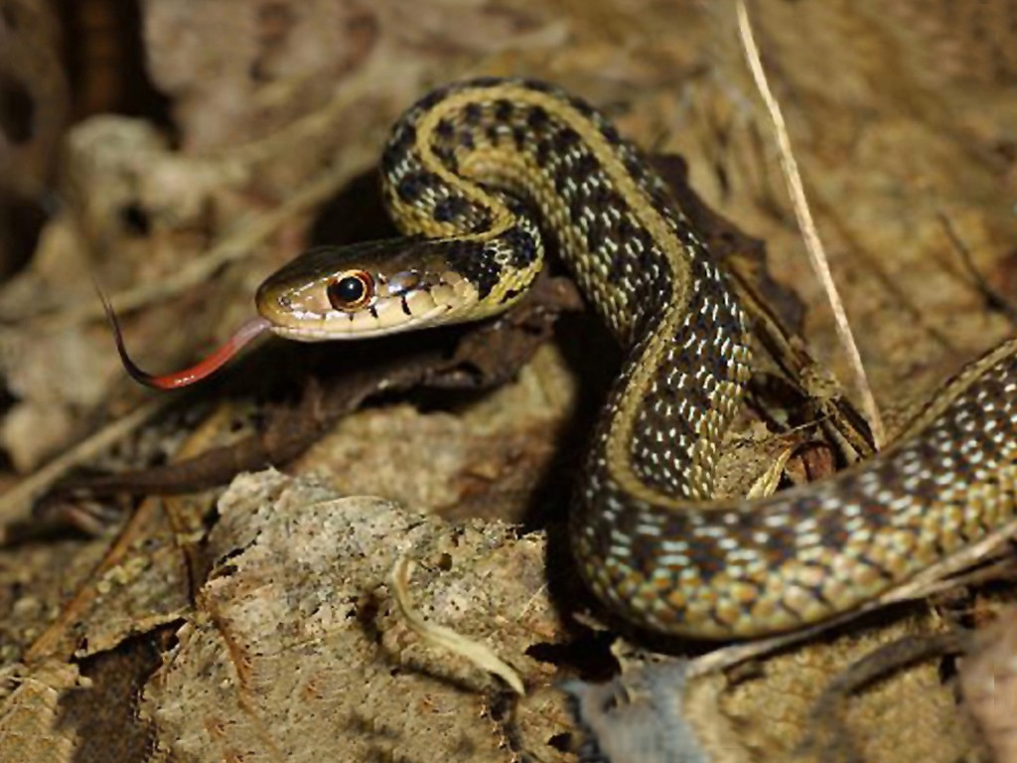
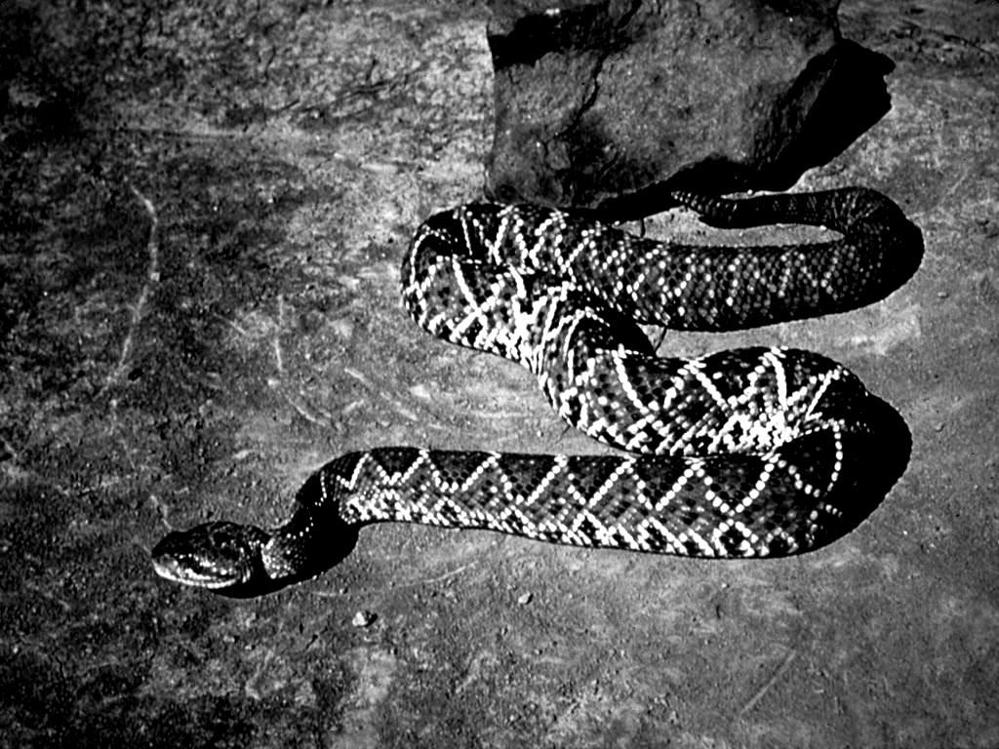
Luminance matching with SHINE
Do all other image processing steps prior to luminance matching
Convert to grayscale, then find average luminance of the set of images
lumMatch
SHINE toolbox download: http://www.mapageweb.umontreal.ca/gosselif/shine/
shine_example.m demonstrates this procedure

Slide 9
Programming your experiment (Using PsychoPy)

Slide 10
SR support forum
The SR support forum has resources and guides for integrating the EyeLink API with your experiment
Sign up for an account: https://www.sr-support.com
The Software Development Kit comes with documentations and example experiments for the most common stimuli presentation languages, including E-Prime, MATLAB, Python, and more.
This demo will focus on PsychoPy

Slide 11
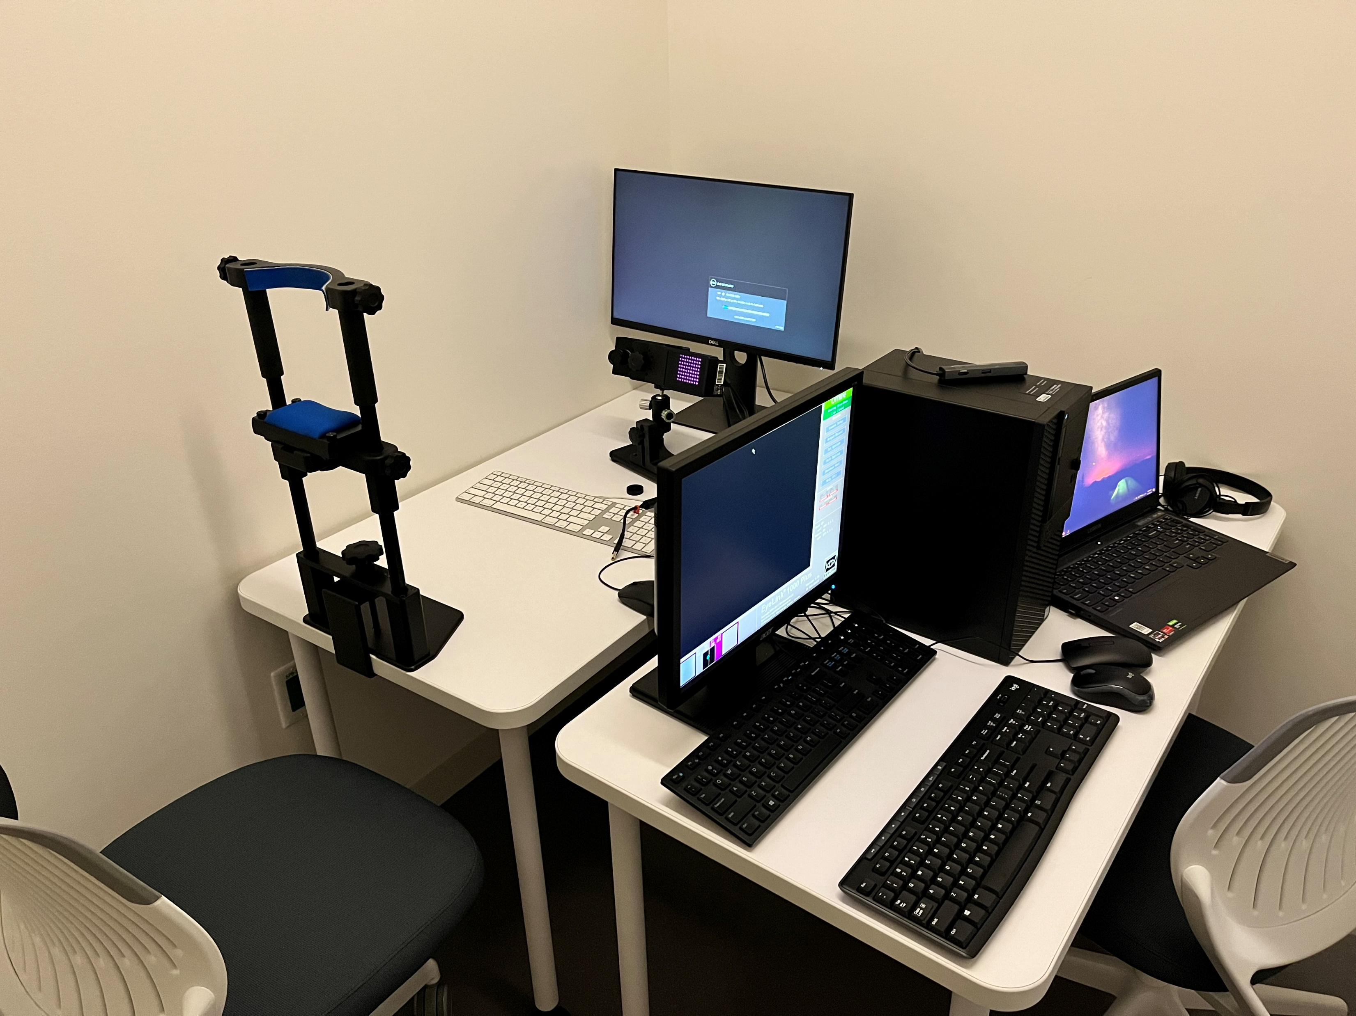
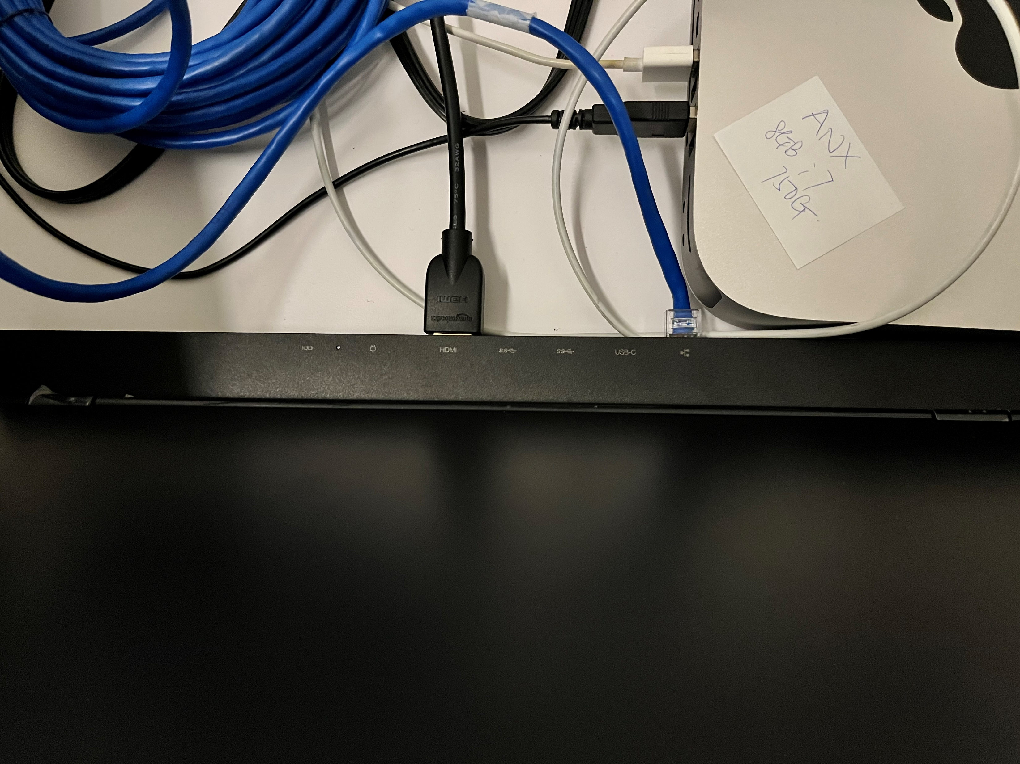
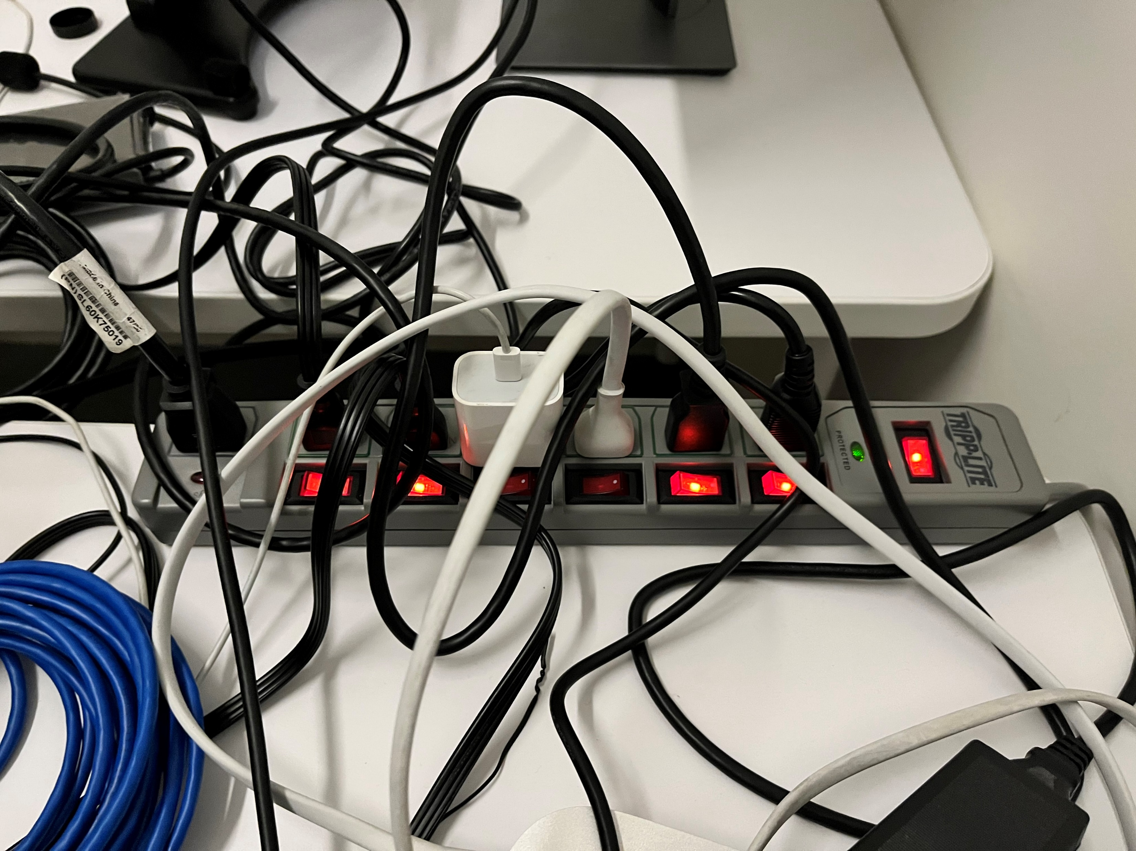
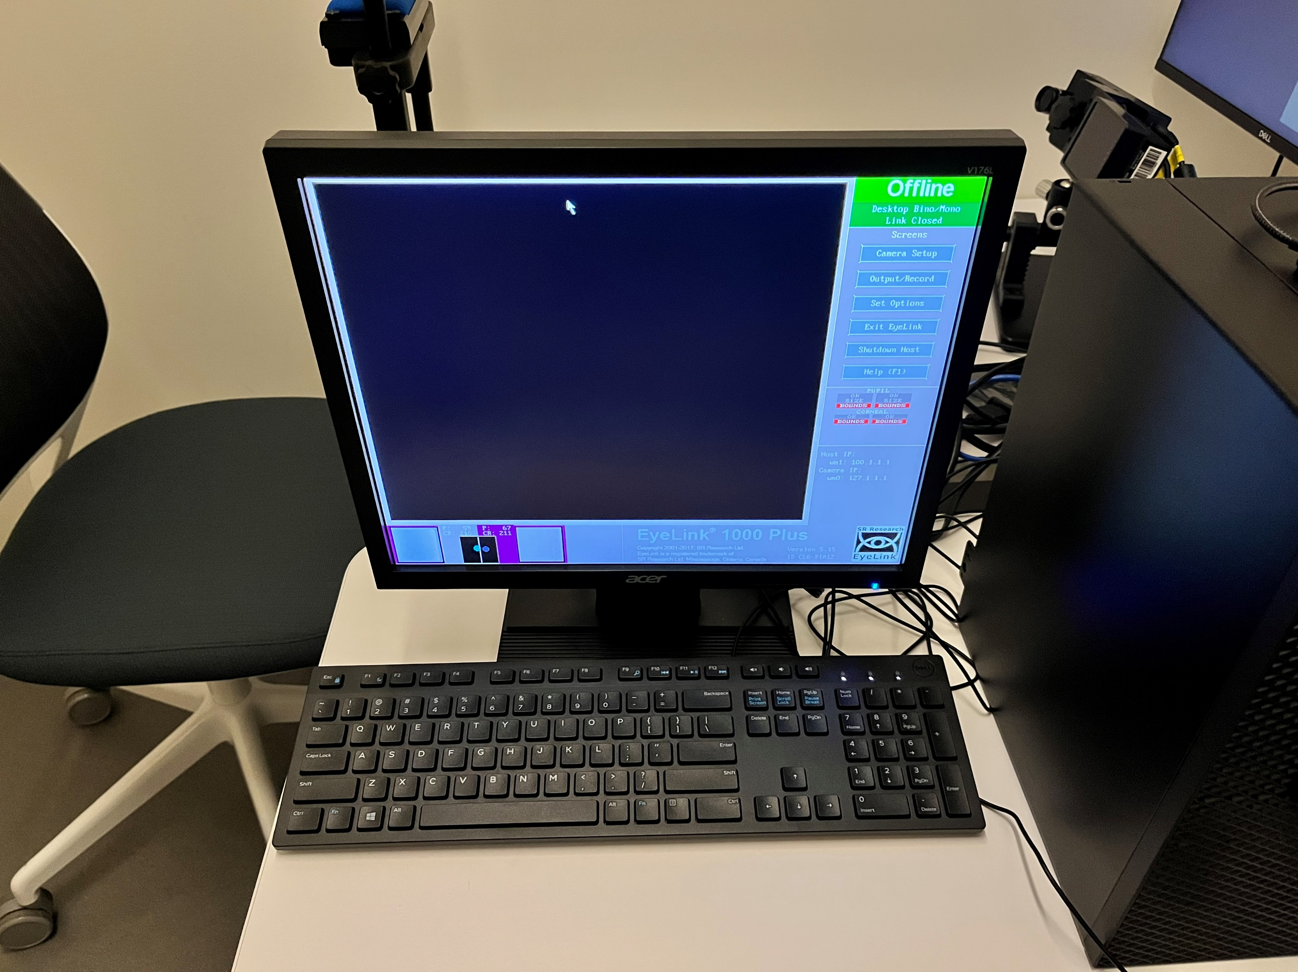
Hardware Overview
Stimuli Monitor
Head Rest
Display PC
EyeLink
HDMI cable connects to experiment display PC
BLUE ethernet cable connects to experiment display PC
Host PC
EyeLink on/off switch
Remember to switch OFF after use!
Host PC controls the eye-tracker
Shut down after use!

Slide 12
A PsychoPy demonstration
A barebones PsychoPy template based on the picture.py example
Trimmed off 1/3rd of the picture.py script
https://github.com/RingoHHuang/ucla-eyelink-demo
picture.py – displays all images in “images” folder
sound.py – plays all audio files in “sounds” folder

Slide 13
Set up your display PC
The display PC is the computer you’ll use to control stimuli presentation. You can use your personal laptop or the Mac Mini in the eye-tracking room.
Configure your Display PC’s network connection to communicate with the EyeLink Host PC
https://www.sr-support.com/showthread.php?tid=281
Install the latest version of the EyeLink SDK for your OS
https://www.sr-support.com/showthread.php?tid=13
3. Install and configure PyLink
https://www.sr-support.com/thread-48.html
PyLink is the Python wrapper for the EyeLink API

Slide 14
Organize experiment directory
One option for organizing your experiment directory:
project_folder
│ experiment_script.py
│ EyeLinkCoreGraphicsPsychoPy.py
│-- results
│ │ participant_id1_datetime.edf │ │ participant_id2_datetime.edf
│ │ participant_id3_datetime.edf
│-- images
│ │ image1.jpg │ │ image2.jpg
│-- sounds
│ │ audio1.wav │ │ audio2.wav
Some convenience functions are in EyeLinkCoreGraphicsPsychoPy.py, so make sure they are accessible

Slide 15
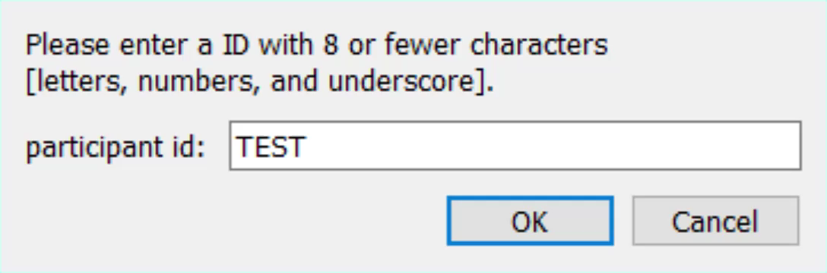
Start up dialog
# Retrieve participant id, which will be used in the edf filename
# The EDF data filename should not exceed 8 alphanumeric characters
# use ONLY number 0-9, letters, & _ (underscore) in the filename
participant_id = 'TEST'
# Prompt user to specify an EDF data filename
# before we open a fullscreen window
dlg_title = 'Enter participant ID'
dlg_prompt = 'Please enter a ID with 8 or fewer characters\n' + \
'[letters, numbers, and underscore].'
# loop until we get a valid filename
while True:
dlg = gui.Dlg(dlg_title)
dlg.addText(dlg_prompt)
dlg.addField('participant id:', participant_id)
# show dialog and wait for OK or Cancel
ok_data = dlg.show()
if dlg.OK: # if ok_data is not None
print('EDF data filename: {}'.format(ok_data[0]))
else:
print('user cancelled')
core.quit()
sys.exit()
# get the string entered by the experimenter
# strip trailing characters
participant_id = dlg.data[0]
edf_fname = participant_id.rstrip()
# check if the filename is valid (length <= 8 & no special char)
allowed_char = ascii_letters + digits + '_'
if not all([c in allowed_char for c in edf_fname]):
print('ERROR: Invalid EDF filename')
elif len(edf_fname) > 8:
print('ERROR: EDF filename should not exceed 8 characters')
else:
break

Slide 16
Create edf output filename
# Set up a folder to store the EDF data files and the associated resources
# e.g., files defining the interest areas used in each trial
results_folder = 'results'
if not os.path.exists(results_folder):
os.makedirs(results_folder)
# We download EDF data file from the EyeLink Host PC to the local hard
# drive at the end of each testing session, here we rename the EDF to
# include session start date/time
time_str = time.strftime("_%Y_%m_%d_%H_%M", time.localtime())
session_identifier = edf_fname + time_str
The edf output is located in the “results” subfolder of the project
The edf filename is derived from the participant ID and the time of recording

Slide 17
Set up connections
# Step 1: Connect to the EyeLink Host PC
#
# The Host IP address, by default, is "100.1.1.1".
# the "el_tracker" objected created here can be accessed through the Pylink
try:
el_tracker = pylink.EyeLink("100.1.1.1")
except RuntimeError as error:
print('ERROR:', error)
core.quit()
sys.exit()
Creates a new pylink object
Establishes a link between EyeLink Host PC and the Python script
# Step 2: Open an EDF data file on the Host PC
edf_file = edf_fname + ".EDF"
try:
el_tracker.openDataFile(edf_file)
except RuntimeError as err:
print('ERROR:', err)
# close the link if we have one open
if el_tracker.isConnected():
el_tracker.close()
core.quit()
sys.exit()
Opens a new edf data file for writing on the Host PC

Slide 18
Configure the recording
# Step 3: Configure the tracker
#
# Put the tracker in offline mode before we change tracking parameters
el_tracker.setOfflineMode()
# Get the software version: 1-EyeLink I, 2-EyeLink II, 3/4-EyeLink 1000,
# 5-EyeLink 1000 Plus, 6-Portable DUO
vstr = el_tracker.getTrackerVersionString()
eyelink_ver = int(vstr.split()[-1].split('.')[0])
# print out some version info in the shell
print('Running experiment on %s, version %d' % (vstr, eyelink_ver))
# File and Link data control
# what eye events to save in the EDF file, include everything by default
file_event_flags = 'LEFT,RIGHT,FIXATION,SACCADE,BLINK,MESSAGE,BUTTON,INPUT'
# what eye events to make available over the link, include everything by default
link_event_flags = 'LEFT,RIGHT,FIXATION,SACCADE,BLINK,BUTTON,FIXUPDATE,INPUT'
# what sample data to save in the EDF data file and to make available
# over the link, include the 'HTARGET' flag to save head target sticker
# data for supported eye trackers
if eyelink_ver > 3:
file_sample_flags = 'LEFT,RIGHT,GAZE,HREF,RAW,AREA,HTARGET,GAZERES,BUTTON,STATUS,INPUT'
link_sample_flags = 'LEFT,RIGHT,GAZE,GAZERES,AREA,HTARGET,STATUS,INPUT'
else:
file_sample_flags = 'LEFT,RIGHT,GAZE,HREF,RAW,AREA,GAZERES,BUTTON,STATUS,INPUT'
link_sample_flags = 'LEFT,RIGHT,GAZE,GAZERES,AREA,STATUS,INPUT'
el_tracker.sendCommand("file_event_filter = %s" % file_event_flags)
el_tracker.sendCommand("file_sample_data = %s" % file_sample_flags)
el_tracker.sendCommand("link_event_filter = %s" % link_event_flags)
el_tracker.sendCommand("link_sample_data = %s" % link_sample_flags)
Specify the variables that you want to record (file_event_flags) and the variables that you may want to access in your Python script (link_event_flags ??)

Slide 19
Configure the calibration
# Step 4: set up a graphics environment for calibration
#
# Choose a calibration type, H3, HV3, HV5, HV13 (HV = horizontal/vertical),
el_tracker.sendCommand("calibration_type = HV9")
# Open a window, be sure to specify monitor parameters
mon = monitors.Monitor('myMonitor', width=53.0, distance=70.0)
win = visual.Window(fullscr=True,
monitor=mon,
screen=1,
winType='pyglet',
units='pix')
# get the native screen resolution used by PsychoPy
scn_width, scn_height = win.size
# Pass the display pixel coordinates (left, top, right, bottom) to the tracker
# see the EyeLink Installation Guide, "Customizing Screen Settings"
el_coords = "screen_pixel_coords = 0 0 %d %d" % (scn_width - 1, scn_height - 1)
el_tracker.sendCommand(el_coords)
# Write a DISPLAY_COORDS message to the EDF file
# Data Viewer needs this piece of info for proper visualization, see Data
# Viewer User Manual, "Protocol for EyeLink Data to Viewer Integration"
dv_coords = "DISPLAY_COORDS 0 0 %d %d" % (scn_width - 1, scn_height - 1)
el_tracker.sendMessage(dv_coords)
# Configure a graphics environment (genv) for tracker calibration
genv = EyeLinkCoreGraphicsPsychoPy(el_tracker, win)
print(genv) # print out the version number of the CoreGraphics library
# Set background and foreground colors for the calibration target
# in PsychoPy, (-1, -1, -1)=black, (1, 1, 1)=white, (0, 0, 0)=mid-gray
foreground_color = (-1, -1, -1)
background_color = win.color
genv.setCalibrationColors(foreground_color, background_color)
# Request Pylink to use the PsychoPy window we opened above for calibration
pylink.openGraphicsEx(genv)
Here, you set up the calibration/validation environment
Optional configurations are not included here

Slide 20
Optional calibration specifications
OPTIONAL
# Set up the calibration target
#
# The target could be a "circle" (default), a "picture", a "movie" clip,
# or a rotating "spiral". To configure the type of calibration target, set
# genv.setTargetType to "circle", "picture", "movie", or "spiral", e.g.,
# genv.setTargetType('picture')
#
# Use gen.setPictureTarget() to set a "picture" target
# genv.setPictureTarget(os.path.join('images', 'fixTarget.bmp'))
#
# Use genv.setMovieTarget() to set a "movie" target
# genv.setMovieTarget(os.path.join('videos', 'calibVid.mov'))
# Use a picture as the calibration target
genv.setTargetType('picture')
genv.setPictureTarget(os.path.join('images', 'fixTarget.bmp'))
# Configure the size of the calibration target (in pixels)
# this option applies only to "circle" and "spiral" targets
# genv.setTargetSize(24)
# Beeps to play during calibration, validation and drift correction
# parameters: target, good, error
# target -- sound to play when target moves
# good -- sound to play on successful operation
# error -- sound to play on failure or interruption
# Each parameter could be ''--default sound, 'off'--no sound, or a wav file
genv.setCalibrationSounds('', '', '')
If you want to specify any of these optional specifications, they would go before the last line of code of the previous slide
Refer to manual for details about these options

Slide 21
Define helper functions
def terminate_task():
""" Terminate the task gracefully and retrieve the EDF data file
file_to_retrieve: The EDF on the Host that we would like to download
win: the current window used by the experimental script
"""
el_tracker = pylink.getEYELINK()
if el_tracker.isConnected():
# Terminate the current trial first if the task terminated prematurely
error = el_tracker.isRecording()
if error == pylink.TRIAL_OK:
abort_trial()
# Put tracker in Offline mode
el_tracker.setOfflineMode()
# Clear the Host PC screen and wait for 500 ms
el_tracker.sendCommand('clear_screen 0')
pylink.msecDelay(500)
# Close the edf data file on the Host
el_tracker.closeDataFile()
# Show a file transfer message on the screen
msg = 'EDF data is transferring from EyeLink Host PC...'
show_msg(win, msg, wait_for_keypress=False)
# Download the EDF data file from the Host PC to a local data folder
# parameters: source_file_on_the_host, destination_file_on_local_drive
local_edf = os.path.join(session_folder, session_identifier + '.EDF')
try:
el_tracker.receiveDataFile(edf_file, local_edf)
except RuntimeError as error:
print('ERROR:', error)
# Close the link to the tracker.
el_tracker.close()
# close the PsychoPy window
win.close()
# quit PsychoPy
core.quit()
sys.exit()
def clear_screen(win):
""" clear up the PsychoPy window"""
win.fillColor = genv.getBackgroundColor()
win.flip()
def show_msg(win, text, wait_for_keypress=True):
""" Show task instructions on screen"""
msg = visual.TextStim(win, text,
color=genv.getForegroundColor(),
wrapWidth=scn_width/2)
clear_screen(win)
msg.draw()
win.flip()
# wait indefinitely, terminates upon any key press
if wait_for_keypress:
event.waitKeys()
clear_screen(win)
def abort_trial():
"""Ends recording """
el_tracker = pylink.getEYELINK()
# Stop recording
if el_tracker.isRecording():
# add 100 ms to catch final trial events
pylink.pumpDelay(100)
el_tracker.stopRecording()
# clear the screen
clear_screen(win)
# Send a message to clear the Data Viewer screen
bgcolor_RGB = (116, 116, 116)
el_tracker.sendMessage('!V CLEAR %d %d %d' % bgcolor_RGB)
# send a message to mark trial end
el_tracker.sendMessage('TRIAL_RESULT %d' % pylink.TRIAL_ERROR)
return pylink.TRIAL_ERROR

Slide 22
Trial routine function (PyLink Calls)
Only showing pylink-related code
# get a reference to the currently active EyeLink connection
el_tracker = pylink.getEYELINK()
# put the tracker in the offline mode first
el_tracker.setOfflineMode()
# clear the host screen before we draw the backdrop
el_tracker.sendCommand('clear_screen 0')
# send a "TRIALID" message to mark the start of a trial, see Data
# Viewer User Manual, "Protocol for EyeLink Data to Viewer Integration"
el_tracker.sendMessage('TRIALID %d' % trial_index)
# record_status_message : show some info on the Host PC
# here we show how many trial has been tested
status_msg = 'TRIAL number %d' % trial_index
el_tracker.sendCommand("record_status_message '%s'" % status_msg)
# put tracker in idle/offline mode before recording
el_tracker.setOfflineMode()
At the start of this trial, retrieve the currently active EyeLink connection.
Then, send some messages to the Host PC.
# Start recording
# arguments: sample_to_file, events_to_file, sample_over_link,
# event_over_link (1-yes, 0-no)
try:
el_tracker.startRecording(1, 1, 1, 1)
except RuntimeError as error:
print("ERROR:", error)
abort_trial()
return pylink.TRIAL_ERROR
# Allocate some time for the tracker to cache some samples
pylink.pumpDelay(100)
Start recording at the beginning of each trial.

Slide 23
Trial routine function (PyLink Calls)
Log messages in the edf file to mark task events.
Messages are useful for aligning the timestamps of the eye-tracking samples to task events.
# show the image, and log a message to mark the onset of the image
clear_screen(win)
img.draw()
win.flip()
el_tracker.sendMessage('image_onset_%d' % trial_index)
img_onset_time = core.getTime() # record the image onset time
This message marks the onset of an image and its trial #
# clear the screen
clear_screen(win)
el_tracker.sendMessage('blank_screen_%d' % trial_index)
This message marks the offset of an image and its trial #

Slide 24
Trial routine function (PyLink Calls)
# stop recording; add 100 msec to catch final events before stopping
pylink.pumpDelay(100)
el_tracker.stopRecording()
Stop recording at the end of the trial.
Note: In most cases, I would not start/stop recording for each trial. It’s often useful to record pupil data during interstimulus intervals.
# record trial variables to the EDF data file, for details, see Data
# Viewer User Manual, "Protocol for EyeLink Data to Viewer Integration"
el_tracker.sendMessage('!V TRIAL_VAR image %s' % pic)
el_tracker.sendMessage('!V TRIAL_VAR RT %d' % RT)
# send a 'TRIAL_RESULT' message to mark the end of trial, see Data
# Viewer User Manual, "Protocol for EyeLink Data to Viewer Integration"
el_tracker.sendMessage('TRIAL_RESULT %d' % pylink.TRIAL_OK)
These messages are only necessary if you want to use EyeLink Data Viewer for analyses (I think)

Slide 25
Run doTrackerSetup()
# Step 5: Set up the camera and calibrate the tracker
# Show the task instructions
task_msg = 'In the task, you may press the SPACEBAR to end a trial\n' + \
'\nPress Ctrl-C to if you need to quit the task early\n'
task_msg = task_msg + '\nNow, press ENTER twice to calibrate tracker'
show_msg(win, task_msg)
try:
el_tracker.doTrackerSetup()
except RuntimeError as err:
print('ERROR:', err)
el_tracker.exitCalibration()
This convenience function pulls up the calibration/validation sequences as well as lets you adjust the eye-tracker settings.

Slide 26
Run experiment trials
# Step 6: Run the experimental trials, index all the trials
# Grab all images from "images folder"
trials = os.listdir('images')
# randomize the trial list
random.shuffle(trials)
trial_index = 1
for trial_pars in trials:
run_trial(trial_pars, trial_index)
trial_index += 1
This section is your normal PsychoPy experiment script.
After completing the experiment, call the terminate_task() helper function to clean up the EyeLink connections.
# Step 7: disconnect, download the EDF file, then terminate the task
terminate_task()

Slide 27
Drift Check (Optional)
# drift check
# we recommend drift-check at the beginning of each trial
# the doDriftCorrect() function requires target position in integers
# the last two arguments:
# draw_target (1-default, 0-draw the target then call doDriftCorrect)
# allow_setup (1-press ESCAPE to recalibrate, 0-not allowed)
#
while not 1:
# terminate the task if no longer connected to the tracker or
# user pressed Ctrl-C to terminate the task
if (not el_tracker.isConnected()) or el_tracker.breakPressed():
terminate_task()
return pylink.ABORT_EXPT
# drift-check and re-do camera setup if ESCAPE is pressed
try:
error = el_tracker.doDriftCorrect(int(scn_width/2.0),
int(scn_height/2.0), 1, 1)
# break following a success drift-check
if error is not pylink.ESC_KEY:
break
except:
pass
If you are doing gaze – it might be worthwhile to include a drift check every so often.
If drift check fails, you can recalibrate.

Slide 28
Running the session

Slide 29
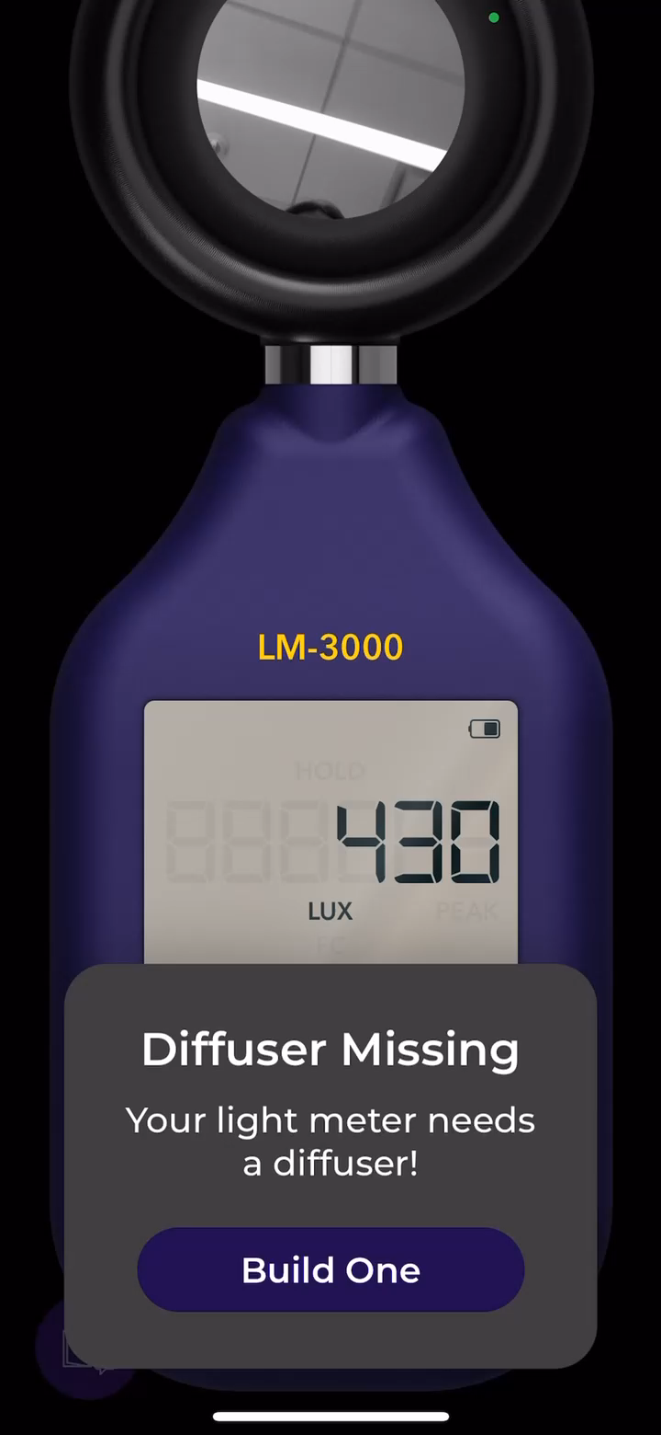
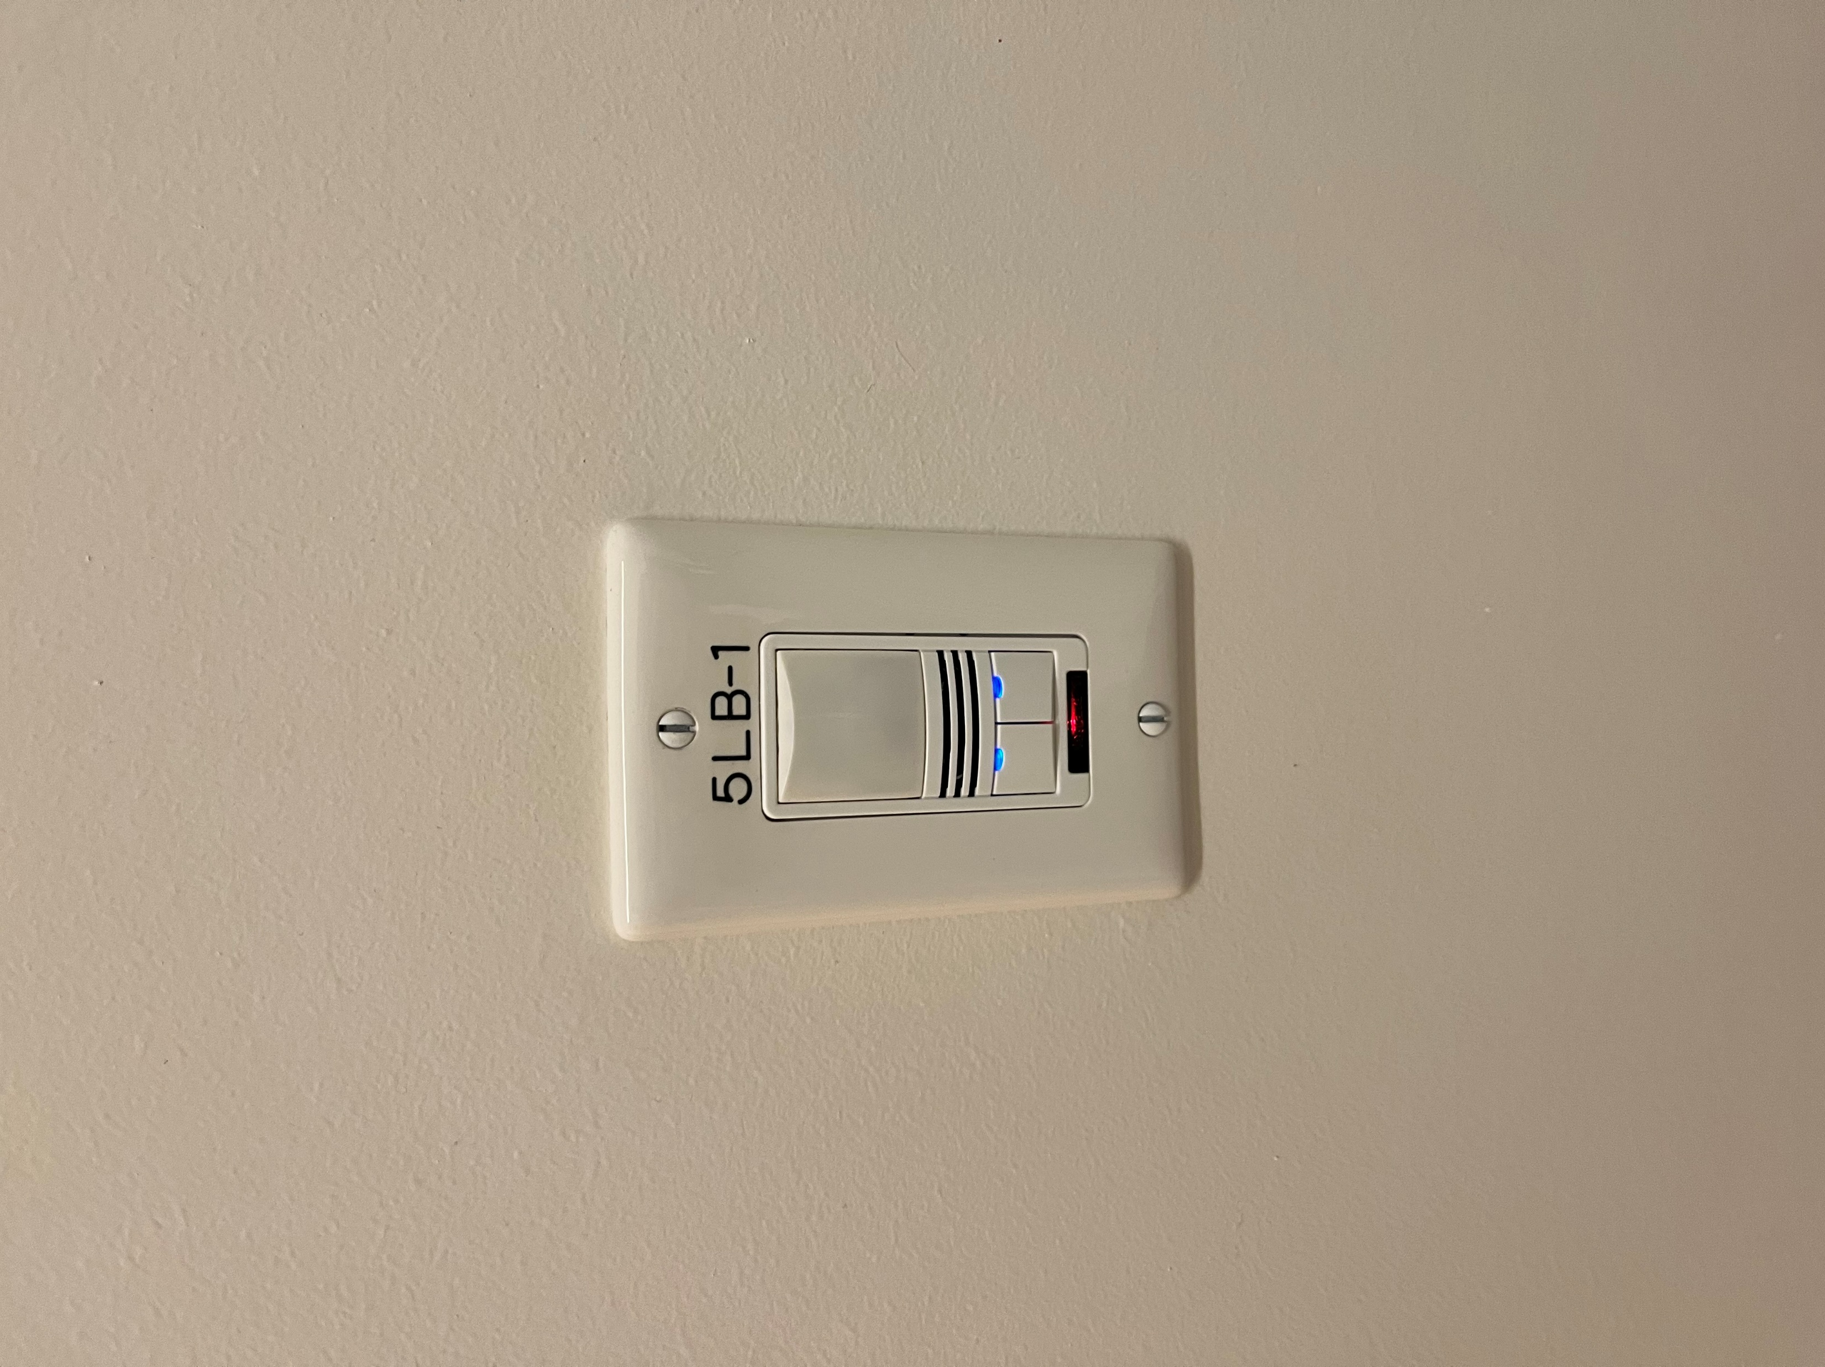
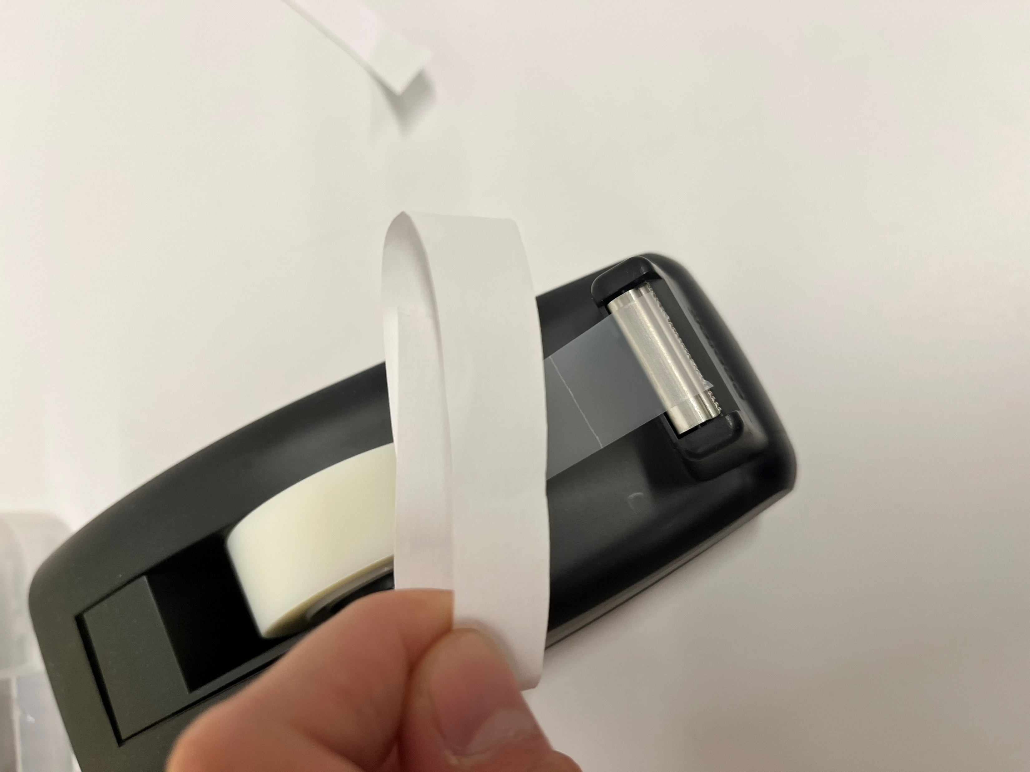
Light Meter
You may want to control the luminance level of the eye-tracking room between sessions
100 lux (?)
iOS App: Light Meter LM-3000
Hold LEFT to BRIGHTEN
Hold RIGHT to DIM
Make your own light diffuser with a strip of paper and tape

Slide 30
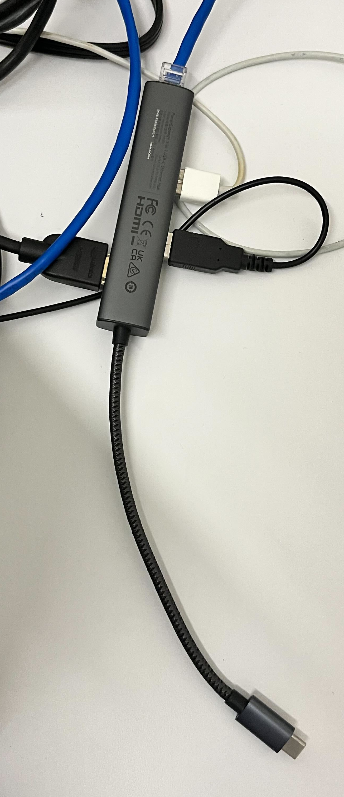
Before the participant arrives
Turn on Host PC and Display PC
Attach the blue ethernet cable and the HDMI cable to your Display PC (use the USB-C dongle if necessary)
Check the luminance of the room
Turn on lights (push left button once)
Close door and make sure all other light sources are controlled (i.e., the stimulus presentation screen is on, host PC monitor is on, etc.)
Cover your camera lens with the strip of paper
Align your phone so that it’s just above the light switch panel
Brighten/dim the lights until your light meter app reads 100 lx (or whatever value you decide)
Hold LEFT to BRIGHTEN
Hold RIGHT to DIM

Slide 31
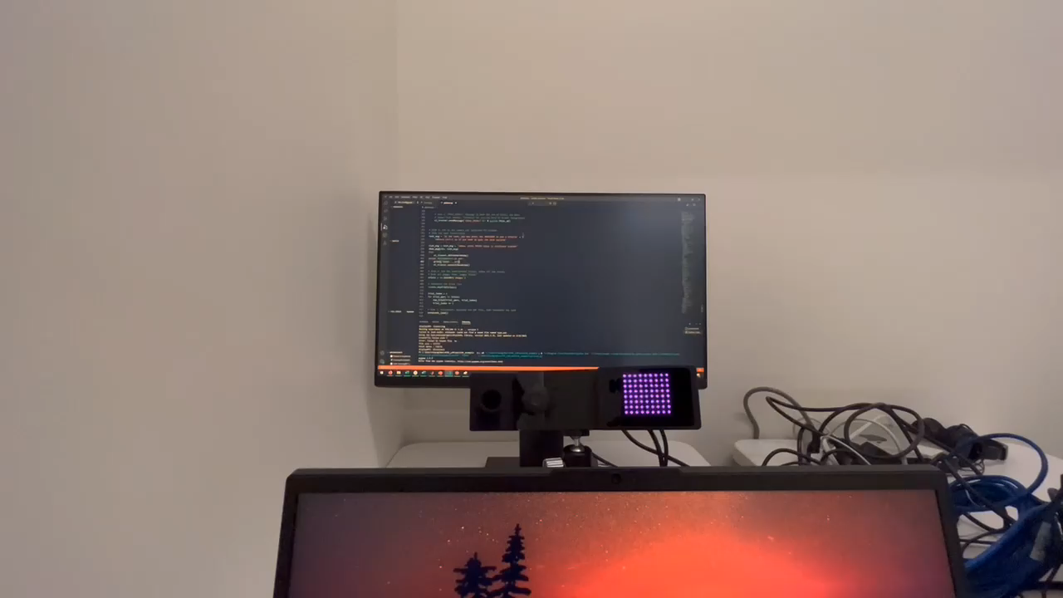
Start up dialog
Showing what happens when you enter more than 8 characters in the prompt

Slide 32
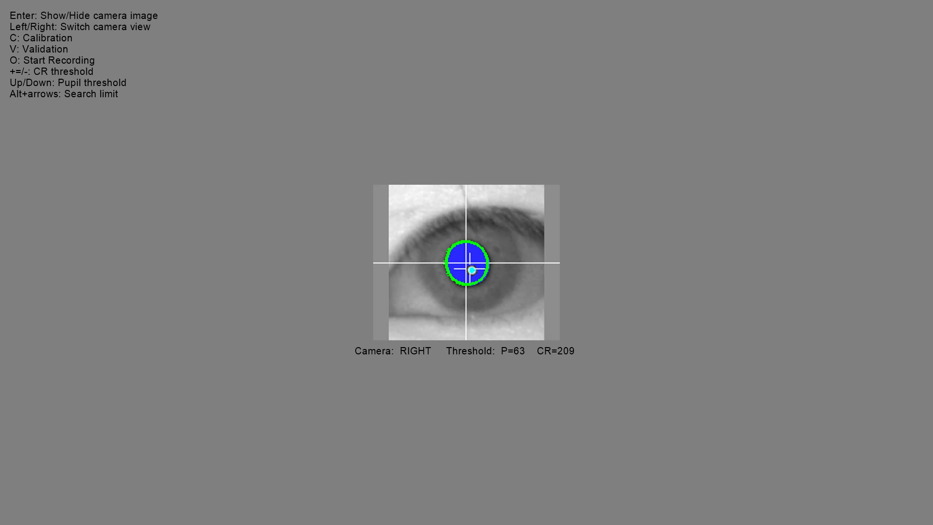
doTrackerSetup() – Set up
el_tracker.doTrackerSetup()
Toggle between camera views using L/R arrow keys.
Set-up:
Search boundaries
CR threshold
Pupil threshold
You can also do the same adjustments on the Host PC

Slide 33
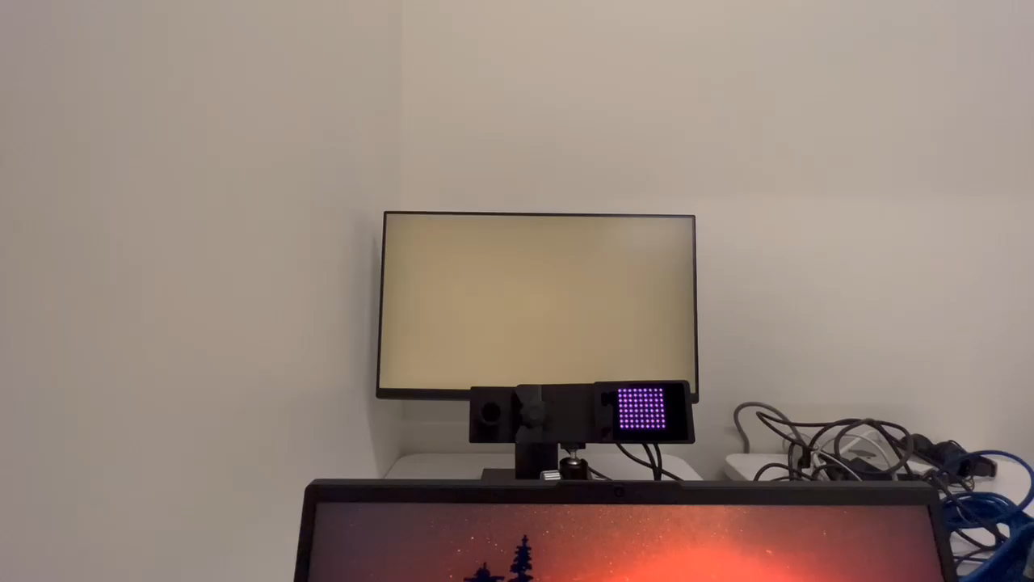
doTrackerSetup() – Calibration/Validation
el_tracker.doTrackerSetup()
Press C to calibrate.
When the circle appears, press spacebar
Automatically advance once fixation is established
Press spacebar to accept calibration
Press V to validate
Note that calibration/validation can also be controlled on the Host PC
Notes:
The video capture is bad

Slide 34
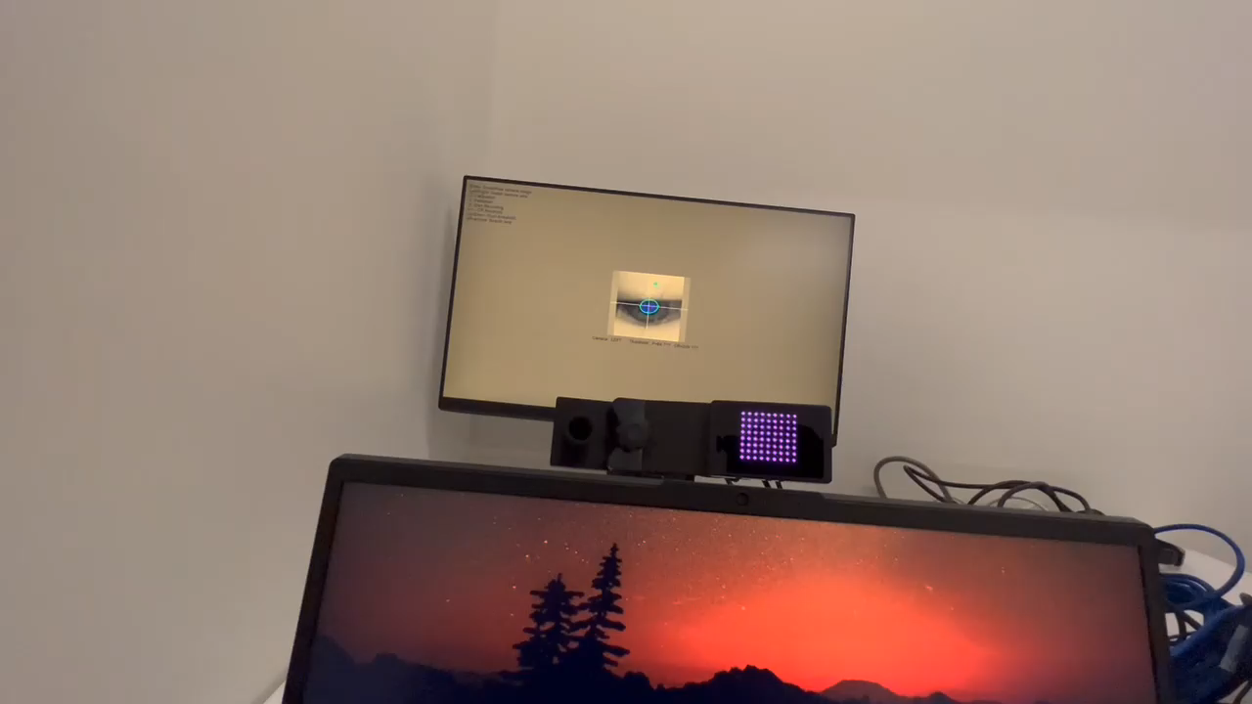
Start Experiment
Press O to start the main experiment.
This completes doTrackerSetup() convenience function and proceeds to the rest of the script.

Slide 35
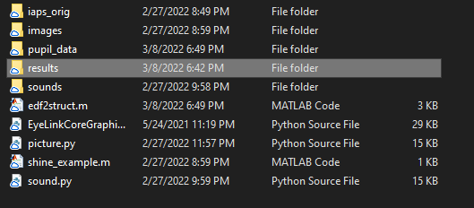
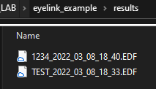
Data output
.edf files are saved in your results folder

Slide 36
Data Processing

Slide 37

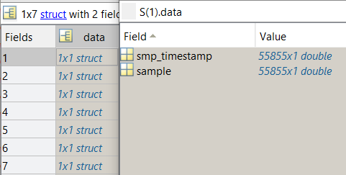
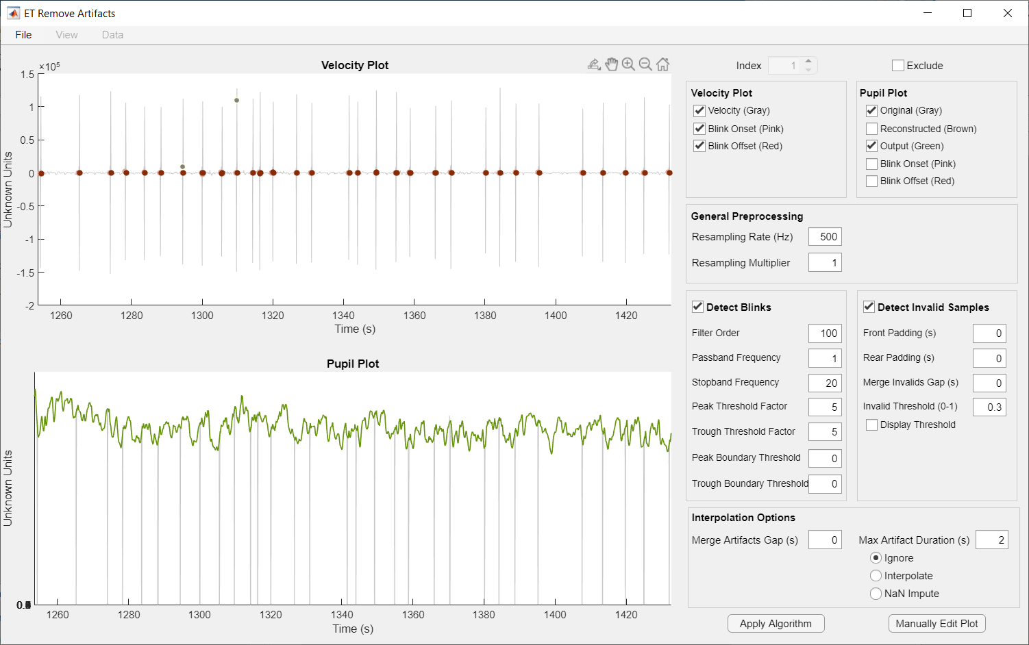
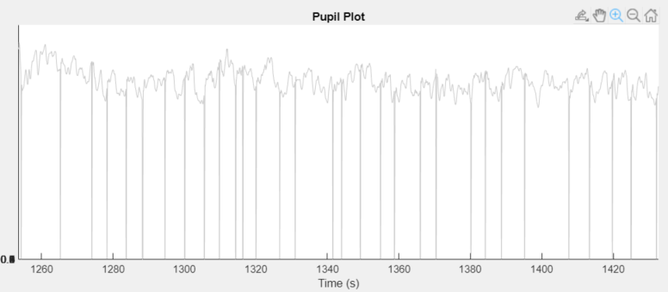
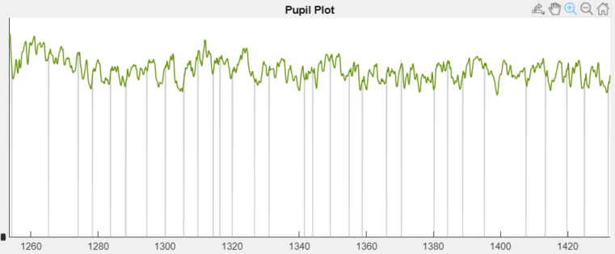
Removing artifacts from your pupil data
ET-Remove-Artifacts Pipeline (github.com/EmotionCognitionLab/ET-remove-artifacts)
Raw Pupil Data
Matlab data structure (.mat)
ET-remove-artifacts
Preprocessed
Pupil Data

Slide 38
For UCLA Cognitive Area EyeLink System:
edf2struct.m
edf file
edfmex
Matlab data structure
Data structure compatible with ET-remove-artifacts
Cleaned Pupil Data
ET-remove-artifacts
Calculate pupil dilation, aggregate across trials, create timecourse plots, stats, etc.

Slide 39
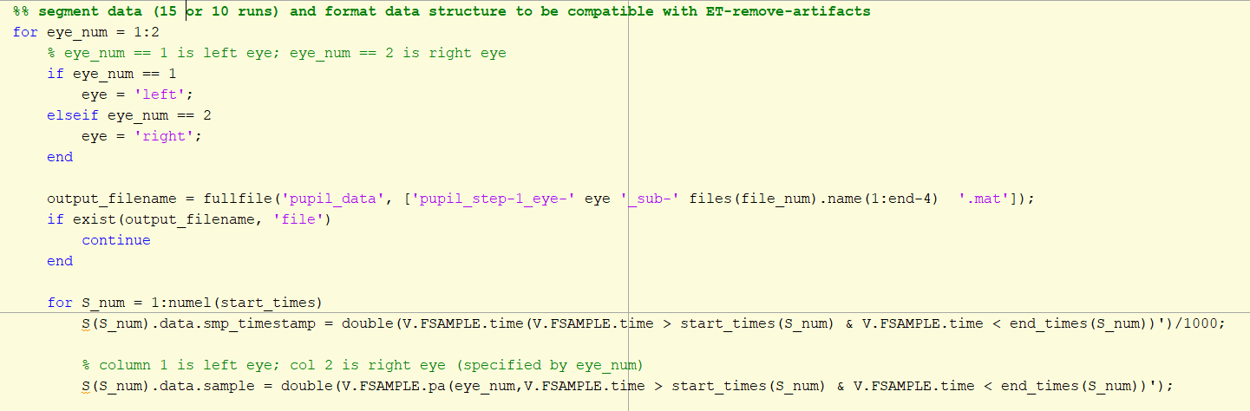
Convert edf file to Matlab data structure
Download edfmex from SR support forum and add it to your path
edf2struct.m (included in the eyelink_example project) converts edf to a data structure that is compatible with ET-remove-artifacts
Reads all .edf files in “results” sub-folder
Outputs as .mat files in “pupil_data” sub-folder
Two outputs per sub; one per eye
Snippet from edf2struct.m

Slide 40
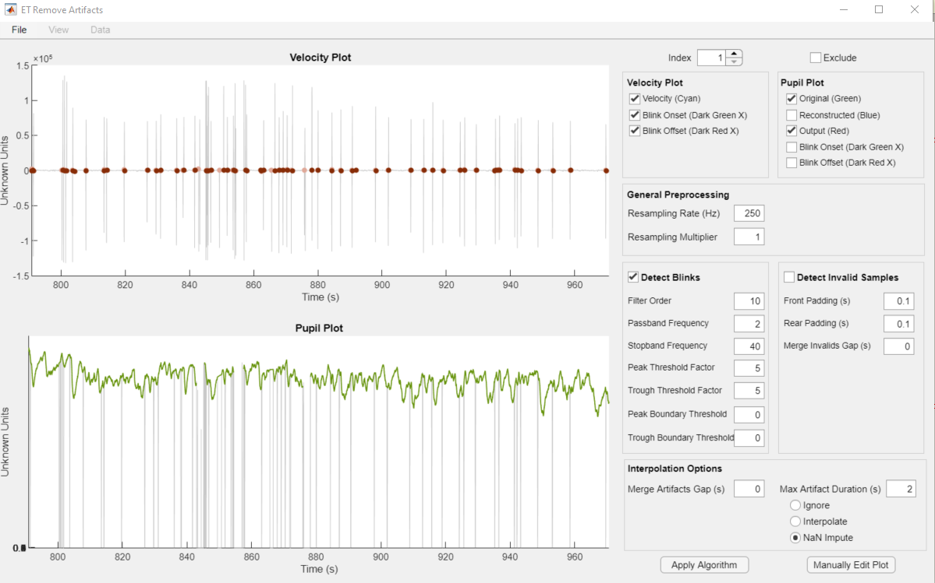
ET-remove-artifacts
See the documentation on the Github repository for details not covered here.
github.com/EmotionCognitionLab/ET-remove-artifacts

Slide 41
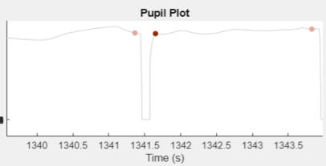
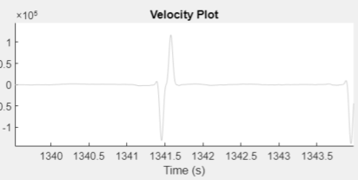
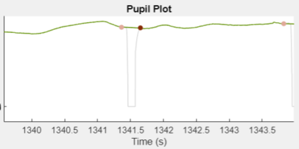
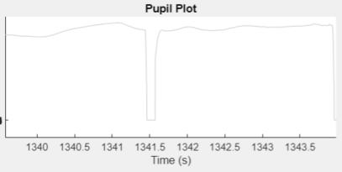
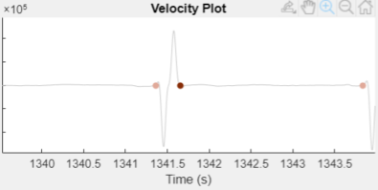
ET-remove-artifacts (algorithm)
The blink detection algorithm:
Derive the velocity plot of the raw pupil data
In terms of velocity, blinks are characterized as a large negative velocity followed by a large positive velocity
2. Detect the onset and offset of blinks
3. Linearly interpolate across the blink, using the onset and offset pupil sample as endpoints

Slide 42
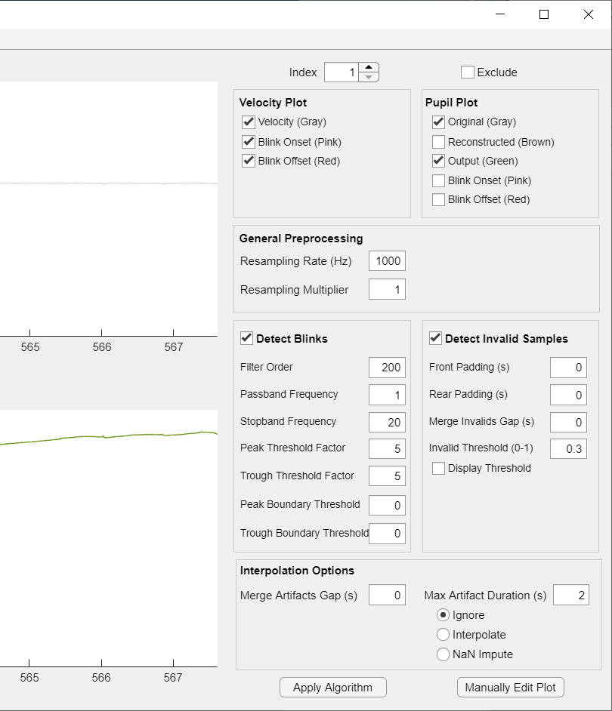
ET-remove-artifacts (default settings)
When you load in your data, the artifact removal algorithm is automatically applied with the default settings
Detects the sampling rate of your data
Specifies a filter order for the differentiator filter based on the sample rate
Detects blinks based on the blink detection algorithm
Also detects invalid samples which are samples that fall below 30% of the range of all samples
Imputes artifacts longer than 2s with NaNs

Slide 43
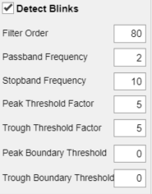
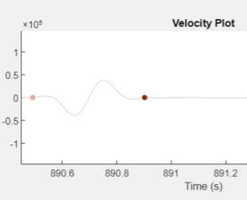
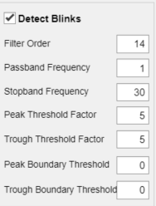
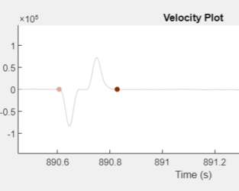
ET-remove-artifacts (differentiator filter)
The first 3 parameters control the filtered derivative used to get the velocity plot.
A larger filter order and smaller frequency band (i.e., difference between passband and stopband) makes the velocity plot smoother.
A smaller filter order and larger frequency band makes the blink profiles more prominent.

Slide 44
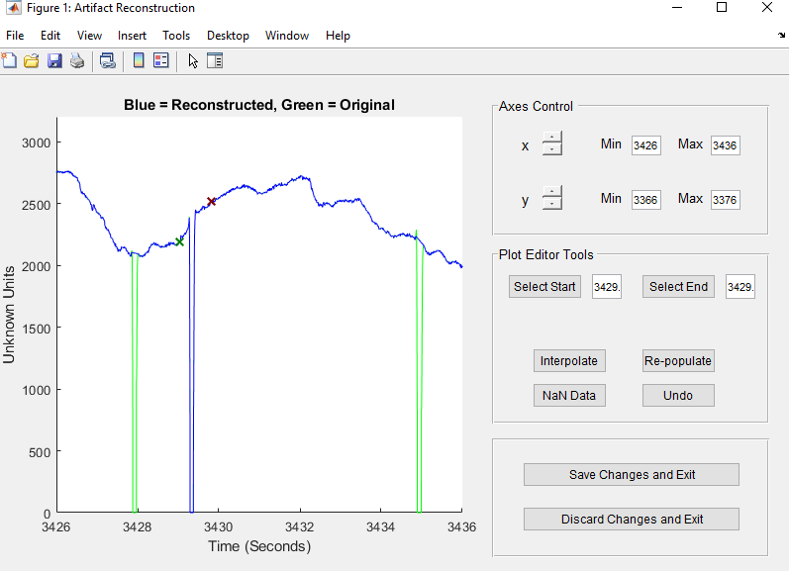
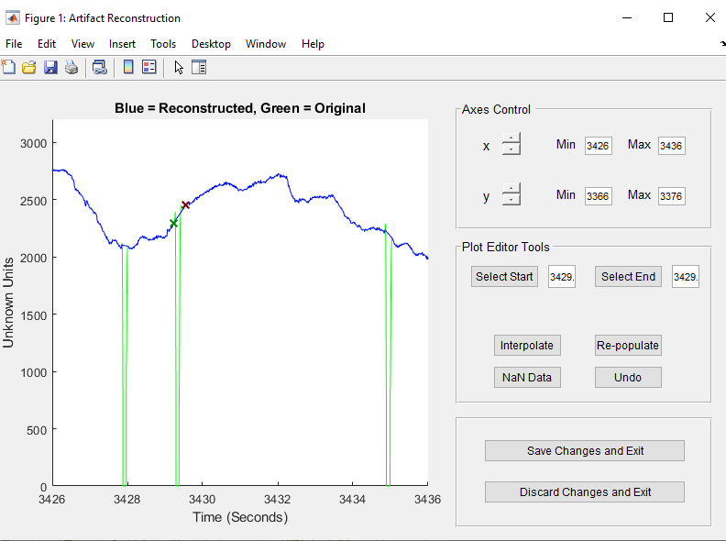
ET-remove-artifacts (manual)
If there are artifacts that weren’t properly taken care of by the algorithm, you can manually specify a start and end point to linearly interpolate over:

Slide 45
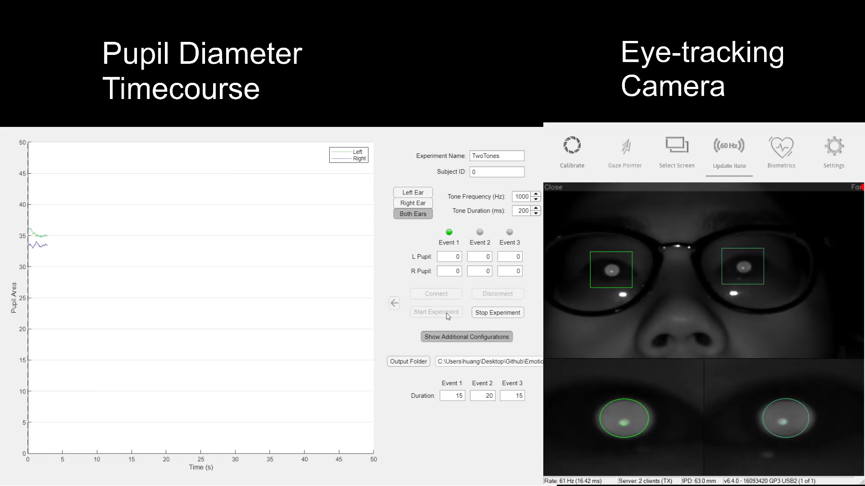
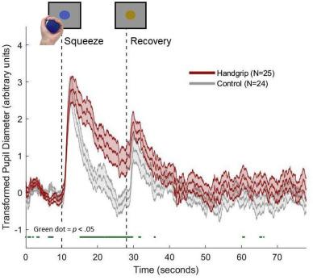
Example of pupil dilation to both mental effort and contextual/perceptual shift

Slide 46
Thank you!

Slide 47

Phase 3: memory test (cued recognition) with vividness ratings and eye-tracking
Condition 1 Lures:
60 neutral animals
20 negative animals
80 neutral vehicles
Condition 2 Lures:
60 neutral vehicles
20 neutral vehicles
80 neutral animals
Condition 1:
20 neutral animals
20 negative animals
40 neutral vehicles
Condition 2:
20 neutral vehicles
20 negative vehicles
40 neutral animals
Phase 2: category-matched n-back task
40 neutral animals
40 neutral vehicles
Notes:
Negative images from IAPS
Neutral images from elsewhere
Animals negative = 40
Animals neutral = 160
Vehicles negative = 40
Vehicles neutral = 160

Slide 48
Other sections from the chapter
The local neurobiological mechanisms that enables the “capture” of prioritized processes:
Glutamate Amplifies Noradrenergic Effects (GANE; Mather, Clewett, Sakaki, & Harley (2016), BBS)
2. Increased arousal impairs prefrontal cortex and goal-directed processes
We think the “easy vs hard” performance-arousal curves is really reflecting the goal-directedness of the task
There’s a shift away from PFC-driven information processing towards habitual/emotional information processing

Slide 49
Inverted-U AGT curve describes tonic LC and phasic LC
This describes the underlying neural gain during various tasks
What if the y axis is “information processing”
In a single goal-directed task, the shape of the curve is inverted U. Amygdala curve is monotonically increasing. All information have unique curves

Slide 50
In checkerboard study, does higher pupil diameter predict greater load-induced suppression of VC?
Pupil parametric analysis?
Some sort of linear mixed effects model?

Slide 51

Pupil dilation increases with Task Load

Slide 52

In Value-Directed Learning Paradigms
The greater pupil dilation reflects greater arousal response for words paired with high value may
In terms of information processing, this may indicate:
Increased capacity – participants may be engaging in more rehearsal
Increased selectivity – increased arousal selectively benefits the high value words
Ariel & Castel (2014). Exp Brain Res

Slide 53


